Slide 1
Distributed Systems
International Institute of Information Technology
Hyderabad, India
Pictures not cited explicitly are taken from the course book or wikepedia.

Slide 2
Vector Time
Data Structures Week 1
Time is represented by n-dimensional non-negative integer vectors.
Each process p_{i} maintains a vector vt_{i} [1..n], where vt_{i}[i] is the local logical clock of p_{i} and describes the logical time progress at process p_{i}.
Vt_{i}[j] represents process p_{i} ’s latest knowledge of process p_{j} local time.
If vt_{i} [j]=x, then process p_{i} knows that local time at process p_{j} has progressed till x.
The entire vector vt_{i} constitutes p_{i} ’s view of the global logical time and is used to timestamp events.
The timestamp of an event is the value of the vector clock of its process when the event is executed.

Slide 3
Vector Time – Update Rules
Data Structures Week 1
Rules for Process p_{i} to update its clock:
Rule 1: Before executing an event, process p_{i} updates its local logical time as follows:
vt_{i} [i] := vt_{i}[i] + d where (d > 0)
Rule2: Each message m is piggybacked with the vector clock vt of the sender process at sending time. On the receipt of such a message (m,vt), process p_{i} executes the following sequence of actions:
    Update its global logical time as follows:
    1 ≤ k ≤ n : vt_{i}[k] := max(vt_{i}[k], vt[k])
    Execute Rule1.
    Deliver the message m.

Slide 4
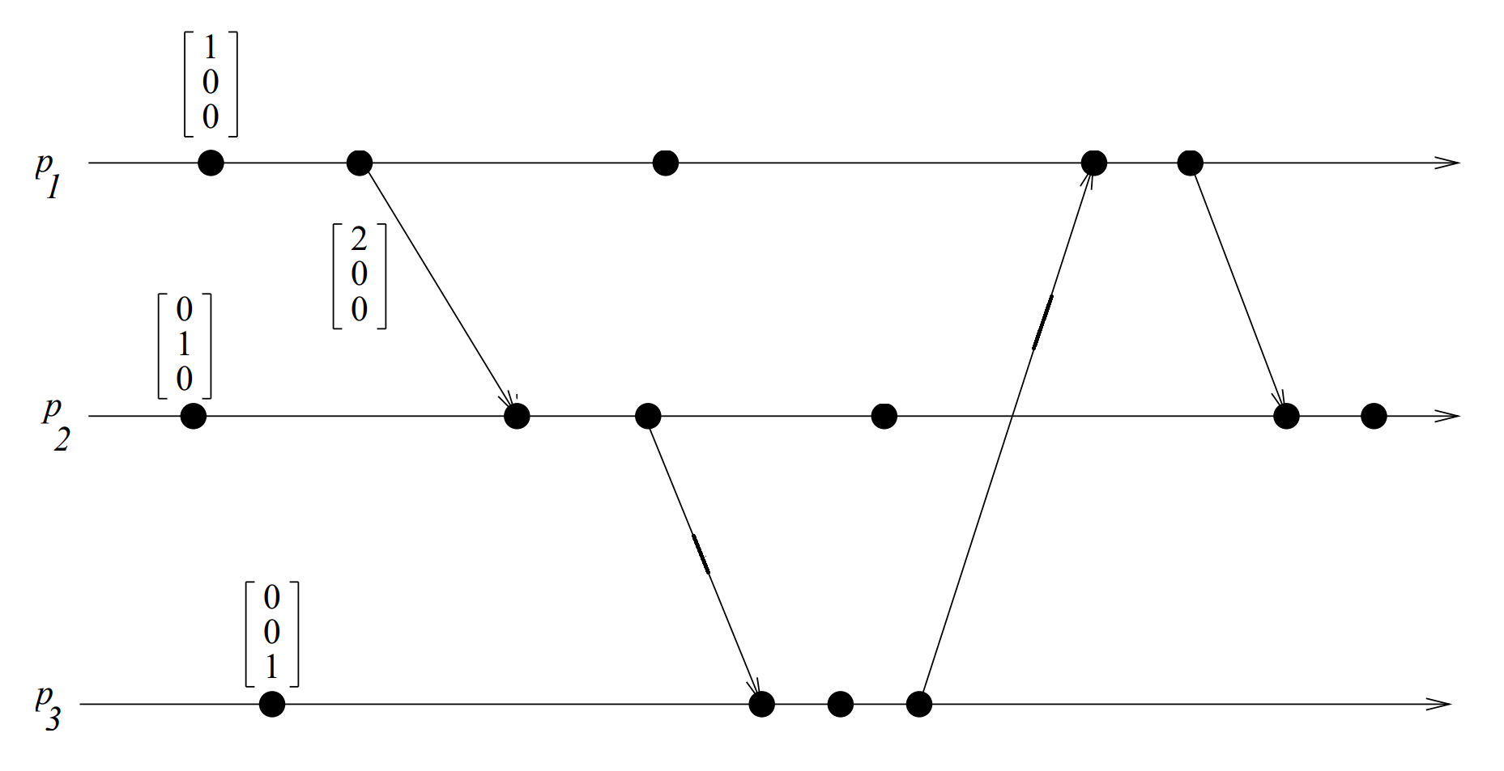
Vector Time – Example
Data Structures Week 1
P2’s second event:
max([2,0,0], [0,1,0])=[2,1,0]
Then Rule1: [2,2,0]

Slide 5
Data Structures Week 1
For process i, for d=1, are the events internal to the process ordered as a sequence1,2,3,4,....
That is for process i: will Vi[i] always be increasing as 1,2,3,4,5,…and so on or can there be values skipped?

Slide 6
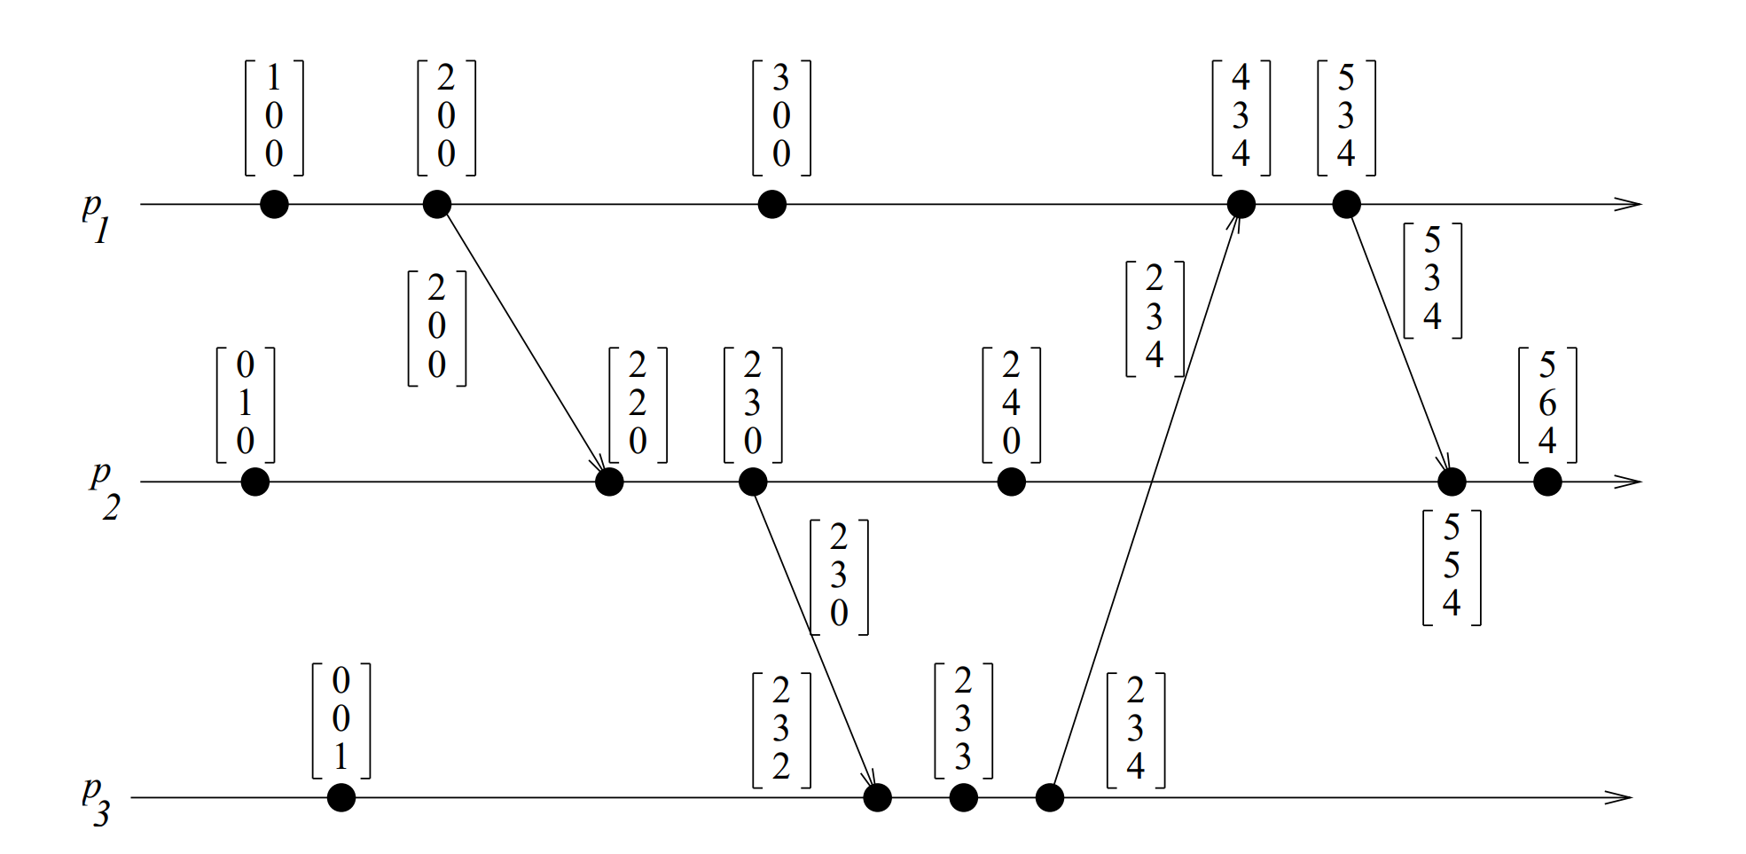
Vector Time – Example
Data Structures Week 1
Initially, a vector clock is [0, 0, 0, ...., 0]. d = 1.
Fill the timestamps for the other events.

Slide 7
Vector Time – Example
Data Structures Week 1
Using vector clocks, two timestamps vh and vk are compared as follows.
vh == vk iff for all indices i, vh[i] == vk[i]
vh <= vk iff for all indices i, vh[i] ≤ vk[i]
vh < vk iff vh ≤ vk and there exists an index i where vh[i] < vk[i].
vh || vk iff not(vh < vk) and not(vk < vh)

Slide 8
Properties of Vector Time
Data Structures Week 1
Event Counting: Use d = 1 always.
Then the i th component of vector clock at process p_{i},vt_{i}[i], denotes the number of events that have occurred at p_{i} until that instant.
So, if an event e has timestamp vh, vh[j] denotes the number of events executed by process p_{j} that causally precede e.
How many events causally precede e in the distributed computation ?

Slide 9
Properties of Vector Time
Data Structures Week 1
Event Counting: Use d = 1 always.
Then the i th component of vector clock at process p_{i},vt_{i}[i], denotes the number of events that have occurred at p_{i} until that instant.
So, if an event e has timestamp vh, vh[j] denotes the number of events executed by process p_{j} that causally precede e. Clearly, (Σ_{j} vh[j] ) − 1 represents the total number of events that causally precede e in the distributed computation.

Slide 10
Properties of Vector Time
Data Structures Week 1
Are Vector clocks strongly consistent ?

Slide 11
Properties of Vector Time
Data Structures Week 1
Strong Consistency: Vector clocks are strongly consistent.
What are the limitations of the vector clock?

Slide 12
Limitations of Vector Time
Data Structures Week 1
Large message sizes owing to the vector being piggybacked on each message.
The message overhead grows linearly with the number of processors in the system and when there are thousands of processors in the system, the message size becomes huge even if there are only a few events occurring in few processors.
Few techniques exist to reduce the overhead.
What can we do to reduce the load?

Slide 13
Vector Time – Example
Data Structures Week 1
Initially, a vector clock is [0, 0, 0, ...., 0]. d = 1.
Fill the timestamps for the other events.

Slide 14
Optimizations
Data Structures Week 1
Consider a message from P_{i} to P_{j}.
The message includes the vector time at P_{i}.
Of the n components of the vector time, only few would have changed since the last time P_{i} sent a message to P_{j}.
Need to include only those tuples.
  (i₁, t₁), (i₂, t₂), ...
Update rule changes slightly so that:
  P_{j} updates the component k of its vector time to max{vt_{j}[k], tk} where tk is the time reported by P_{i} with the tuple (k, tk)
Are we missing something?

Slide 15
Optimizations
Data Structures Week 1
Message sizes decrease in general, but local storage may increase.
  Need to know the vector time at P_{i} when the last message was sent to P_{j}, for each j.
  That is, each process stores the last msg sent to every other process.
  O(n²) storage per process.
A clever optimization can bring this storage to O(n) – Singhal kshemkalyanis technique

Slide 16
Singhal- Kshemkalyani Differential Technique
Data Structures Week 1
Process pi maintains the following two additional vectors:
◮LS_{i}[1..n] (‘Last Sent’) : Ls_{i}[j] indicates the value of vt_{i}[i] when process p_{i} last sent a message to process p_{j}.
◮LU_{i}[1..n] (‘Last Update’):LU_{i}[j] indicates the value of vt_{i}[i] when process p_{i} last updated the entry vt_{i}[j].
LU_{i}[i] =vt_{i}[i] ?
When do you update LS and LU ?
Can we put LS and LU together to know what is the information that needs to be piggybacked on the message ?

Slide 17
Singhal- Kshemkalyani Differential Technique
Data Structures Week 1
Process pi maintains the following two additional vectors:
◮LS_{i}[1..n] (‘Last Sent’) : Ls_{i}[j] indicates the value of vt_{i}[i] when process p_{i} last sent a message to process p_{j}.
◮LU_{i}[1..n] (‘Last Update’):LU_{i}[j] indicates the value of vt_{i}[i] when process p_{i} last updated the entry vt_{i}[j].
Clearly,LU_{i}[i] =vt_{i}[i] at all times
Lu_{i}[j] needs to be updated only when the receipt of a message causes p_{i} to update entry vt_{i}[j].
LS_{i}[j] needs to be updated only when p_{i} sends a message to p_{j}

Slide 18
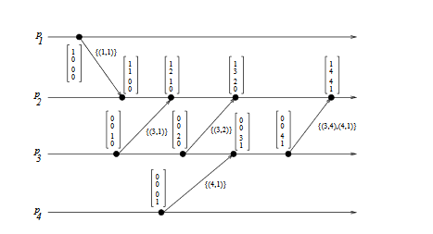
Data Structures Week 1

Slide 19
Singhal- Kshemkalyani Differential Technique
Data Structures Week 1
Since the last communication from pi to pj , only those elements of vector clock vt_{i}[k] have changed for which LS_{i}[j] < Lu_{i}[k] holds. Hence, only these elements need to be sent in a message from p_{i} to p_{j}.
When p_{i} sends a message to p_{j} , it sends only a set of tuples { (x,vt_{i}[x]) | LS_{i}[j] < LU_{i}[x] } as the vector timestamp to p_{j}, instead of sending a vector of n entries in a message.
Home Work !!
Think about whether vector clocks can detect out of order msgs.
Will Singhal-Kshemkalyanis technique work if the messages
are not in FIFO order ?

Slide 20
Homework
Data Structures Week 1
Suppose every process can only broadcast messages. Now, I want to design an algorithm that ensures causal ordering. That is, when two messages arrive at say Pi; they should be delivered in the order they have been sent.
Consider these broadcast msgs that reach out of order where msg b reaches before a.
First P1→a
Next P1 →c
Then, →c P3
Design an algorithm, that will deliver msgs only in order.
Hint: use vector clocks. Assume that on receiving a msg, we don’t increment event number of local process. Event number is incremented only when broadcast made. Hence event number is indicative of number of broadcasts sent out.

Slide 21
Teasers-1
Data Structures Week 1
Suppose an updation event at site D at time t was propagated(broadcasted) to all sites
Nodes need this information to determine when it is safe to discard/stabilize updates.
Can I decipher looking at B’s vector sent to me if B has received the msg from D?

Slide 22
Teasers-1
Data Structures Week 1
Can I decipher looking at B’s vector sent to me if B has received the msg from D?
No. Suppose B received a msg from C before it sent a msg to me then
B updates as
V_{B}[D]= max(V_{B}[D], V_{C}[D]).
Hence we do not know if V_{B}[D] is update from C or an update B already had from D.

Slide 23
Causal Message Ordering
Data Structures Week 1
Causual message ordering: the message which is sent first should be received first. If send (M1)–>send(M2) then for all processes which receive the messages M1 and M2 should receive M1 before M2
OR
If two msgs causually ordered btwn them are sent (even if by two diff processes) to a process P; then process P should receve the msg also by the same causal order.
Consider:
A sends msg to B
B sends to C
A sends to C
At C: C receives two msgs. One from A and other from B. However, the msg sent by B to C is causually ordered after the msg send by A to C. Hence, msg sent by B to C should be received after msg sent by A to C

Slide 24
Teasers-2
Data Structures Week 1
Suppose I want to know whether an updation event at site D at time t which was propagated to all sites has reached everyone assuming causal order and no lost messages:
Consider the below:
B sends msg to me. Can I know if B received the msg from D?

Slide 25
Teasers-2
Data Structures Week 1
Let us assume that B got D’s news through C.
Now, that means there were two msgs with recipient as B. One Is the msg from D and another is a msg from C due to which VB[D]=VC[D].
Now by causual order if two msgs are intended for the same destination; then the one sent first should reach first.
Can the msg from C to B with D’s update be sent before D’s msg to B?
No as D had broadcast all its msgs. So C can be sending the update on D to B only after D sent a msg to B.
Hence D’s msg to B will reach first and the update could not have come through anyone else

Slide 26
Teasers-3
Data Structures Week 1
Once again consider causal order:
I want to know if D’s msg has reached everyone.
Instead of receiving a msg from everyone if I receive a msg from B such that V_{B}[x] >= t for all x then can I conclude that all have received the broadcast from D?

